Slide 1

Procedural Representation
Unlike logic representations which are declarative,
procedural approaches represent knowledge as a set
of instructions for solving problems.

Slide 2
Production Systems (1)
Production systems are a typical example of procedural representations.
A production system has three components:
  A database of facts (also called data memories, or working memories)
  A set of production rules (also called condition-action rules, or production memory)
  An interpreter (also called inference engine)

Slide 3
Production Systems (2)
The database represents all the knowledge of the system at any given moment. Its contents change as facts are added or removed according to the application of rules
Production rules are of the form
    IF <condition> THEN <action>
The principal use of production rules is to change the contents of the database:
  If the condition of a rule becomes true, the action associated with the rule is performed, which usually alters the contents of the database (e.g., adding a fact, removing a fact, or interacts with the outside world in some way).

Slide 4
Production Systems (3)
The interpreter decides which rule to apply and handles any conflicts.
Responsibility:
finding the rules whose conditions are matched by the current state of the database; and then
deciding which rule to apply according some rule-selecting strategies.
Example strategies:
  choosing the first rule that matches.
  choosing the most specific rule.

Slide 5
Production Systems (4)
E.g.,
<age is bigger than 65>
is more specific than
<age is bigger than 60>
but
<age is bigger than 65>
is less specific than
<age is bigger than 65>
and <sex is female>

Slide 6
Production Systems (5)
An example
The production system gives advice on whether to make a loan to a client.
The initial state of the database (default facts):
<client working? is unknown>
<client student? is unknown>
<salary is unknown>
A fact
<AMOUNT REQUESTED is £2000>
is added

Slide 7
Production Systems (6)
Rules
R1. IF <client working? is unknown>
THEN
ask “Are you working”
read WORKING
remove <client working? is unknown>
add <client working? is WORKING>
R2. IF <client working? is YES> and <salary is unknown>
THEN
ask “What is your salary?”
read SALARY
remove <salary? is unknown>
add <salary? is SALARY>

Slide 8
Production Systems (7)
R3. IF <client working? is YES> and
<salary is SALARY> and
SALARY >= (5*AMOUNT REQUESTED)
THEN
grant loan of AMOUNT REQUESTED
clear database
finish
R4. IF <client working? is YES> and
<salary is SALARY> and
SALARY < (5*AMOUNT REQUESTED)
THEN
grant loan of (SALARY/5)
clear database
finish

Slide 9
Production Systems (8)
R5. IF <client working? is NO> and <client student? is unknown>
THEN
ask “Are you a student?”
read STUDENT
remove <client student? is unknown>
add <client student? is STUDENT>
R6. IF <client working? is NO> and <client student? is YES>
THEN
discuss student loan
clear database
finish
R7. IF <client working? is NO> and <client student? is NO>
THEN
refuse loan
clear database
finish

Slide 10
Production Systems (9)
Imagine what will happen if our client is
  working and earns £14000
  working and earns £7500
  not working but a student

Slide 11
Semantic Networks (1)
Network representations capture knowledge as a graph, in which nodes represent objects and arcs represent relationships.
Semantic networks are a typical example of network representation.

Slide 12
Semantic Networks (2)
Systems employing semantic networks have been developed which perform such diverse tasks as:
  translating natural language into formal structures;
  performing logical deduction;
  doing judgmental reasoning;
  reasoning about the structure of data in database;
  reasoning about processes;
  interrelating the sentences of a dialogue;
  generating natural language descriptions of information that is stored in formal structures.

Slide 13
Semantic Networks (3)
Basic structure of semantic networks
A semantic network consists of a collection of nodes interconnected by an accompanying set of arcs.
Each node denotes an object (a physical objects, an animate individual, a set, etc.).
Each arc represents a relationship -- Binary relationships between objects are denoted as arcs from a node to another node (see Figure 1.7.1(a)), and unary relationships denoted as arcs from a node to nowhere represent attributes (or properties) of objects.

Slide 14
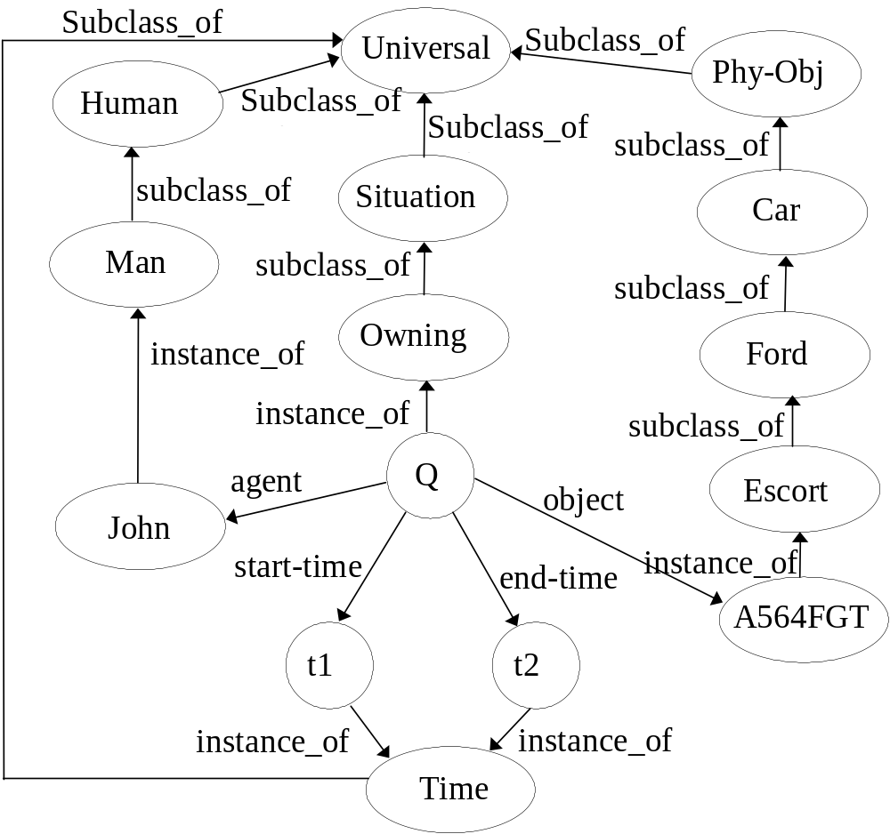
Semantic Networks (4)

Slide 15
Semantic Networks (5)
The node “Universal” denote the universal class of objects (sometimes, this note may be omitted)
Arcs labelled “subclass_of” indicate subclass relationships E.g., the subclass arc from Man to Human indicates that Man, the class of all men, is a subclass of Human.
Arcs labelled “instance_of” indicate membership relationships. E.g., the instance arc from John to Men indicates that John is a member of the class of men and is thus a particular man.
The node “Q” denotes a member of the class “Owning”, the class of situations in which an agent owns an object over some period of time. In turn, “Owning” is a subclass of “Situation”, which is the set of all static conditions and dynamic events. E.g., for the particular situation “Q”, John is the agent that owns the object A564FGT during the period from t1 to t2.

Slide 16
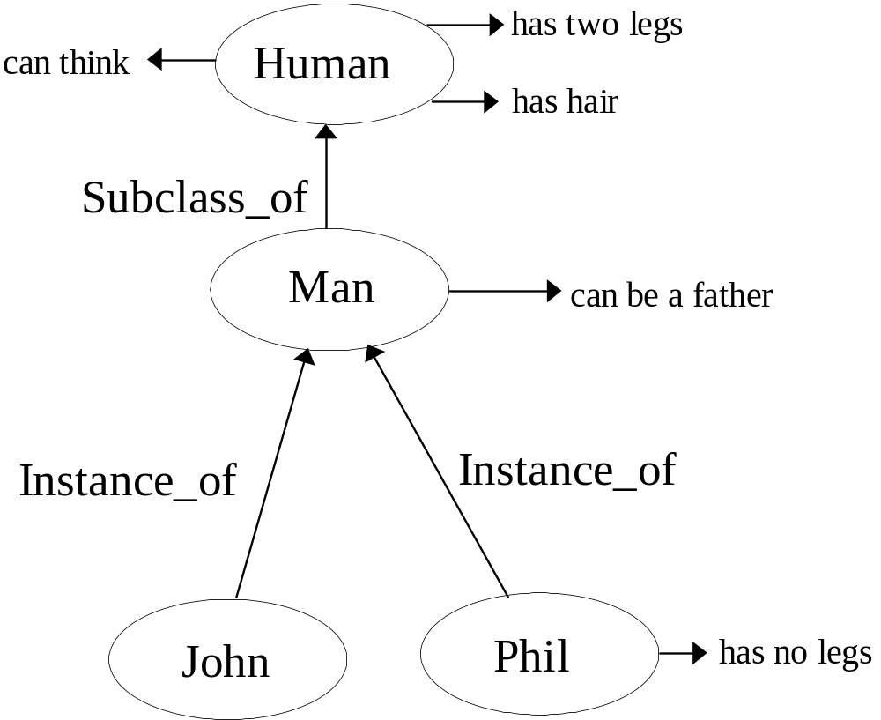
Semantic Networks (6)
property inheritance

Slide 17
Semantic Networks (7)
A class may be a subclass of some parent class, and is assumed to inherit all the attributes of its parent classes. E.g., again, as shown in Figure 1.7.1(b), The class “Human” has attribute “has two legs”, “can think” and “has hair”, hence, “Man”, a subclass of that parent class consequently inherits all these attributes, as well as having its own attribute, “can be a father”.
An object may be a member of a class, and is assumed to have the same attribute values as the parent class (unless alternative values override). E.g., as shown in Figure 1.7.1(b), John is a member of the class of “Man” and a man can be a father, hence, John can be a father. However, although Phil is a member of “Man”, he doesn’t inherit the “Man” ’s property of having two legs, since he has an alternative value, “has no legs”, for that attribute.

Slide 18
Frames (1)
Frames are one of the most common data types of structured representations. Such structures can be linked together as networks, giving property inheritance.
A frame is usually used to represent an object, which refers to some convenient package of information, such as a physical thing (e.g., ball, us) a class of physical things (e.g., toys, people), an abstract entity (e.g., plans, goals, relationships) or a class of abstract entities (reports, emotions).
A frame consists of: a frame name, slots, facets and fillers.

Slide 19
Frames (2)
Slots indicate different properties of the frame object (e.g., name, registration_number, cough_type).
Slot fillers identify the value(s) or status (e.g., patients, humans, yes, dry) associated with particular slots of the frame object. A slot filler may also have some associated facets.
Facets (e.g., value, type) identify different sub-properties of a given slot. They often describe how a particular slot is to be used.

Slide 20

Frame john_doe
SLOT:
Instant_of | facet | filler
 | VALUE | patients
name | facet | filler
 | VALUE | John_doe
Registration_ number | facet | filler
 | VALUE | 816
cough | facet | filler
 | VALUE | yes
cough_type | facet | filler
 | VALUE | productive

Slide 21
Frame patients
SLOT:
subclass_of | facet | filler
 | VALUE | sick_people
name | facet | filler
 | VALUE | unknown
 | facet | filler
 | TYPE | names
registration_ Number | facet | filler
 | VALUE | unknown
 | facet | filler
 | TYPE | integer
cough | facet | filler
 | VALUE | unknown
 | facet | filler
 | TYPE | yes, no
cough_type | facet | filler
 | VALUE | unknown
 | facet | filler
 | TYPE | dry, productive
 | facet | filler
 | CARDINALITY | 1

Slide 22
Reasoning (1)
What is reasoning?
Reasoning is the process of using the knowledge we have to draw or infer new conclusions about a domain of interest

Slide 23
Reasoning (2)
Three key types of reasoning:
  Induction
Induction can be defined as generalisation from cases seen to infer information about cases unseen. E.g.:
Every apple you weighted is lighter than 1.5 kg; therefore you infer that any apple is lighter than 1.5 kg.
Inductive reasoning is the basis of much of our learning and very useful; however, it is not generally reliable. In fact, it is difficult (if not impossible) to weight every apple in the world; in addition, there is no guarantee every apple next year must be lighter than 1.5 kg.

Slide 24
Reasoning (3)
Abduction
Abduction can be defined as the process of reasoning back from something to the state or event that caused it. E.g.:
Suppose you are playing a loud music and your friend is annoyed with you. You may therefore infer that his anger is caused by the noise.
Abductive reasoning is useful in cases where the knowledge is incomplete -- it can provide a “best guess” given the evidence available. However, it too is unreliable. For instance, in the above example, it may be that your friend is angry because you forgot to pay back the money you borrowed from him.

Slide 25
Reasoning (4)
Deduction
Deduction can be defined as the process of deriving the logically necessary conclusion for the initial premises. E.g.:
We can express knowledge “if the battery is flat then headlight won’t work” as:
∀x(BatteryIsFlat(x)→ LightNotWork(x))
Hence, given
BatteryIsFlat(MyCar)
we can deduce
LightNotWork(MyCar)

Slide 26
Reasoning (5)
Consider the inverse: Can we infer
BatteryIsFlat(MyCar)
from
LightNotWork(MyCar)
?
This is not permitted in deductive reasoning. However, we may do so by abductive reasoning; that is, if the headlights don’t work, we may use abduction to derive that the battery is flat, although this inference could be wrong since there may be another explanation for the light failure (e.g., the bulbs may have blown).

Slide 27
Reasoning (6)
Reasoning directions:
Reasoning can progress in one of two directions.
  Forward reasoning
A means of doing symbolic reasoning. It involves examining the conditions (the “IF” part) of a rule to determine whether its conclusion (the “THEN” part) can be drawn; the conclusion can, in turn, satisfy the conditions of other rules, leading to the inference of further conclusions.

Slide 28
Reasoning (7)
E.g.:
With the initial fact “the baby is hungry” and the following rules:
P1: IF the baby is hungry
THEN the baby has a negative feeling
P2: IF the baby is bored
THEN the baby has a negative feeling
P3: IF the baby has a negative feeling
THEN the baby is crying
P4: IF the baby is crying
THEN the baby is kicking the cot to pieces

Slide 29
Reasoning (8)
We can use forward reasoning to reach the conclusion “the baby is kicking the cot to pieces”. The forward chain of productions is: P1 --> P3 --> P4.
Forward reasoning is useful where most of the data is given in the problem statement but where the goal is unknown or where there are a large number of possible goals.

Slide 30
Reasoning (9)
Backward reasoning
A means of doing symbolic reasoning. It involves matching the conclusion (the “THEN” part) of a rule with a goal, i.e., a fact which requires to be established. The goal will be established if the conditions (the “IF” part) of the rule are found to be true -- each condition may already be true; otherwise, it may still be possible to establish a condition’s truth if it is the conclusion in a separate rule. In this case, the condition itself will be posted as a goal to be established and the conditions of the new rule tested in an effort to establish the new goal. Hence, backward reasoning can thus lead through a series of rules, investigating a chain of goals to establish the original goal.

Slide 31
Reasoning (10)
E.g.:
Consider the baby example again. With the initial fact “the baby is hungry”, can we conclude that “the baby is kicking the cot to pieces”.
We can use backward reasoning for such a question, and the answer is YES. In fact, the backward chain used is:
P1 <-- P3 <-- P4
Backward reasoning is most applicable in situations where a goal or hypothesis can be easily generated and where problem data have to be acquired by the solver.

Slide 32

Expert Systems

Slide 33
Expert Systems (1)
An expert system is a program (software) that attempts to mimic human expertise by applying inference methods to a specific body of knowledge. This body of knowledge is called the domain.
Unlike conventional software that process data or information, expert systems process knowledge. Knowledge is usually represented in a computer in the form of rules – they store the heuristics that guide the human expert.
Other features that distinguish expert systems from conventional systems are the capability to explain their reasoning process, and the ability to learn.

Slide 34
Expert Systems (2)
Distinction between data, information and knowledge:
Data is nothing more than a group of symbols:
    6
    6.0
    -6
    Oasis
It is only some context is added to these symbols that they have any benefit - this is called information:
    £6
    6.0 marks awarded in the competition.
    -6⁰C
    Oasis are a successful UK rock group
The following items are knowledge in that they are gained from experience:
    It is raining, therefore I shall get wet.
    The temperature is -60⁰C, so it is cold.
    The engine of the car is hot; it must have been recently used.
    Oasis are affluent musicians.

Slide 35
Expert Systems (3)
Heuristics
Expert systems are considered as a branch of AI because the method of problem solving is predominantly based on heuristics.
Most conventional applications use algorithmic methods for problem solving – an algorithm is a step-by step procedure that solves a category problems, involving direct manipulation of numeric data to produce information.
Heuristics, on the other hand, solve a problem by trial and error guided by some reference to a predetermined goal.

Slide 36
Expert Systems (4)
Inference and inference engine
The real forte of an expert system is its capability to make inferences, that is, to draw conclusions from premises. This is precisely what makes an expert system intelligent.
Even when it is possible to represent domain knowledge as rules, an expert system need an inference engine to decide which rules, and in which order, should be selected for evaluation.
The inference engine is a program that interprets the rules in the knowledge base in order to draw conclusions.
Two main alternative strategies are used with rule-based systems: backward chaining and forward chaining. A particular inference engine may adopt either or both.

Slide 37
Expert Systems (5)
Tools for building expert systems
Special-purpose languages such as Lisp and Prolog are used for developing general AI applications. Building expert systems from scratch with these requires a detailed knowledge of the language itself, and is labour intensive.
Programs called expert system shells are mostly used for building expert systems.
Shells have offered an easy starting point for expert system building because they are expert systems that have been emptied of their rules, which means that developers can concentrate on building only the knowledge base without having to worry about other things such as the inference engine.
However, shells suffer from a lack of flexibility in that it is difficult to modify or change the way they work with regard to both representation of the knowledge and the inference engine.

Slide 38
Expert Systems (6)
The user interface
An expert system user interface is normally of a highly interactive nature, to reflect the form of dialogue that takes places between a client and a human expert.
An expert system user interface will not only enable the user to answer questions but also allow the user to interrupt its running operation by asking for explanations.

Slide 39
Expert Systems (7)
Basic architecture of an expert system:
Knowledge base
(rules and facts)
Stored data
New
data
New
data
Inference
engine
Questions
Solutions
User
interface

